Slide 1
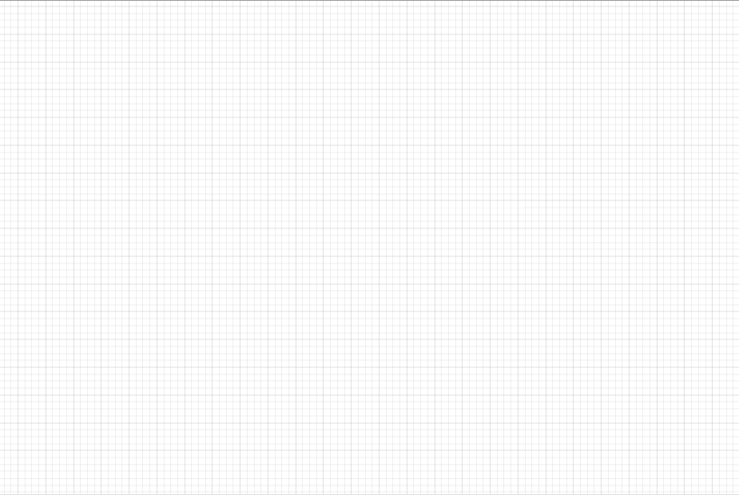
M_Majors
Major_Classes
M_Classes
Cred_Transfers
D_Classes
PK MJID
MajorName
School
PK, FK MJID
PK, FK MarID
PK MarID
Subject
CourseNum
CourseName
Credits
PK, FK DID
PK, FK MarID
PK DID
Subject
CourseNum
CourseName
Credits
Students
Students_Classes
PK, FK DID
PK, FK SID
PK, FK SID
M_Minors
Minor_Classes
Sessions
PK MinID
MinorName
School
PK ,FK MinID
PK, FK MarID
PK SesID
FK SID
People
Admins
PK PID
FName
LName
EmailAdd
PK, FK AID
UserName
Password

